Slide 1
E – Channeling System
Largest Doctor Channeling Network in Sri Lanka

Slide 2
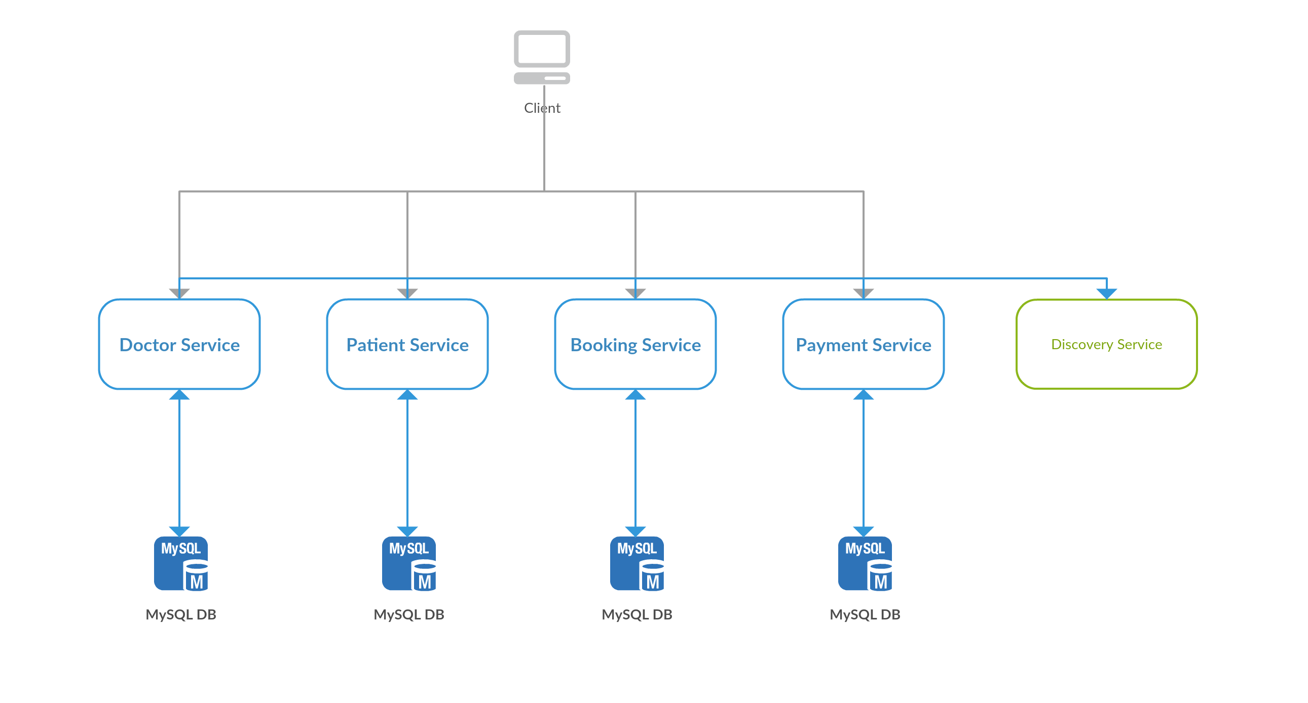

Slide 3
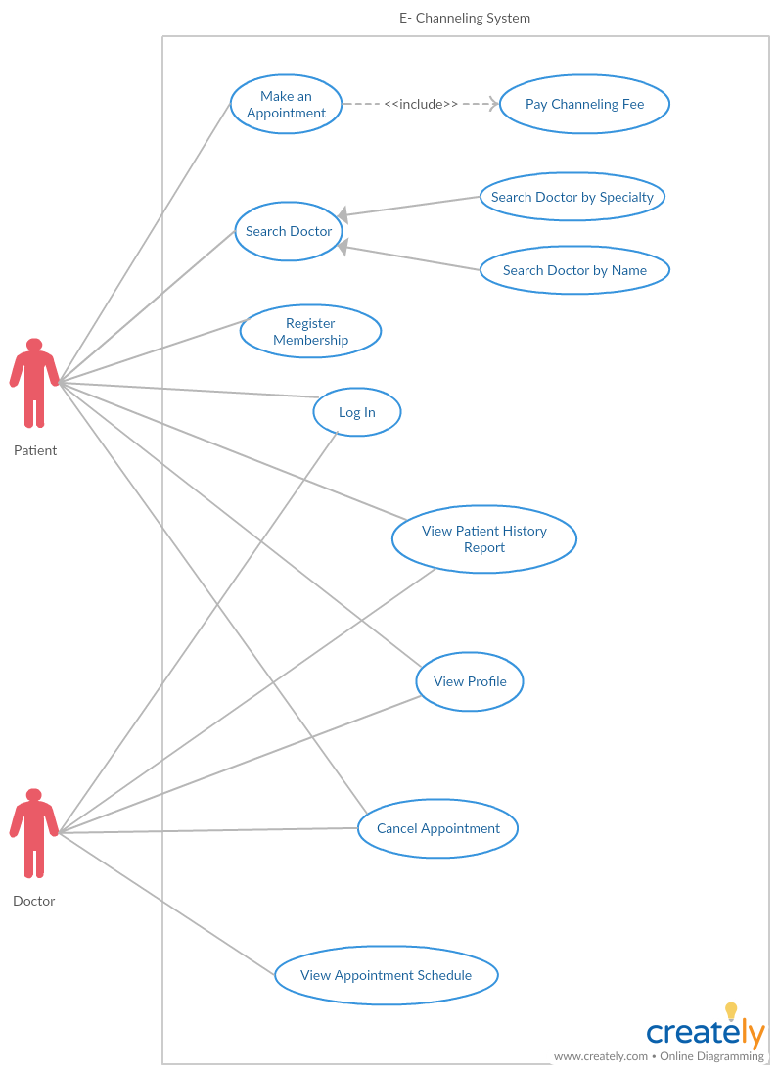

Slide 4
Services in the System
Doctor Service
Patient Service
Booking Service
Payment Service

